Slide 1

END TERM SDP EVALUATION
MACHINE LEARNING MODEL TO DIAGNOSE BREAST CANCER
Supervised By: Dr.Trushna Parida
Group K14:
Priyambada Sahu (2051012015)
Madhusmita Jena (1941012932)
Swayam Sarthak Rout (1941012640) Aditya Ku. Samal (1941012931)
Department of Computer Sc. and Engineering
Faculty of Engineering & Technology (ITER)
Siksha ‘O’ Anusandhan (Deemed to be) University
Bhubaneswar, Odisha
1

Slide 2
Presentation Outline
Introduction
Motivations
Uniqueness of the work
Literature Survey
Existing System
Problem Identification
Schematic Layout OR Model Diagram
Methods OR Tools OR Algorithms used
Experimentation and Results
System Specifications
Datasets Description
Parameters used (if any)
Experimental outcomes (Tables and Figures)
Results Analysis and Validation
Conclusion and Future Scope (Key findings)
Bibliography
2

Slide 3
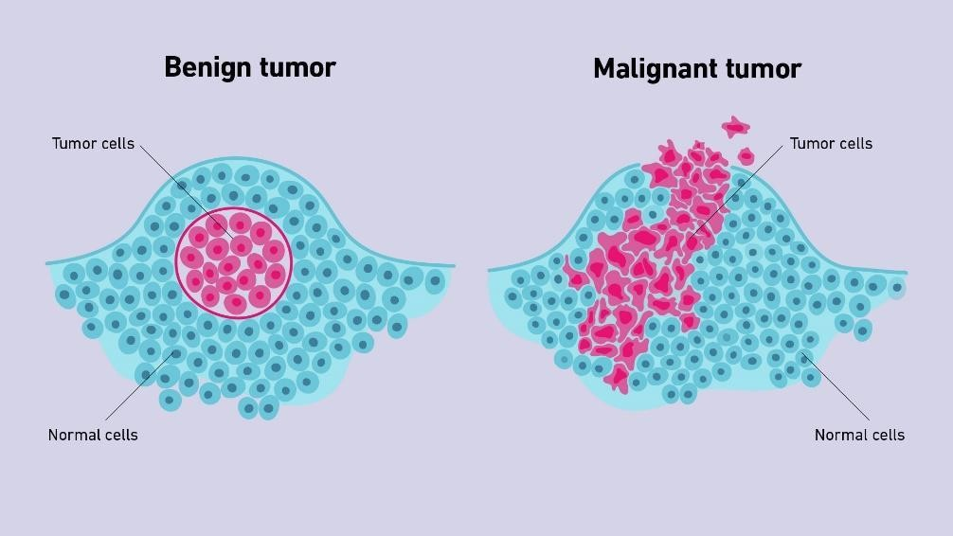
Introduction
Overview
Breast cancer is a cancer that starts in breast tissue. It happens when cells in the breast change and grow out of control. The cells usually form a tumor.
There are two types of breast cancer: malignant
and benign.
Malignant means it is a cancerous cell and benign means it is a non-cancerous cell.
Fig 1.1: Pictorial representation of benign tumor and malignant tumor [Source: Internet]
3

Slide 4
Motivations
Alcohol—Studies indicate that drinking alcohol can slightly increases the risk.
Age— Most breast cancer—about 79% of new cases and 88% of breast
cancer deaths occur in women 50 years of age and older.
Family history—About 30% of women who develop breast cancer have a family history of the disease.
So these risk factors are pushing us a step forward to build a model, that will help for diagnosing breast cancer.
Until true primary prevention is developed, it is necessary to makethe examination ever more efficient, economical, and safe.

Slide 5
Literature Survey
Existing System
The primary key in women’s survival from breast cancer is early detection and proper treatment. Many existing screening and emerging technology tools are used for the detection of the early stages of breast cancer. As illustrated
in Figure 1.2, the current breast cancer detection tools are classified into two categories: body imaging-based technology and microwave imaging-based technology. Block diagram of different modalities in breast cancer detection.
6

Slide 6
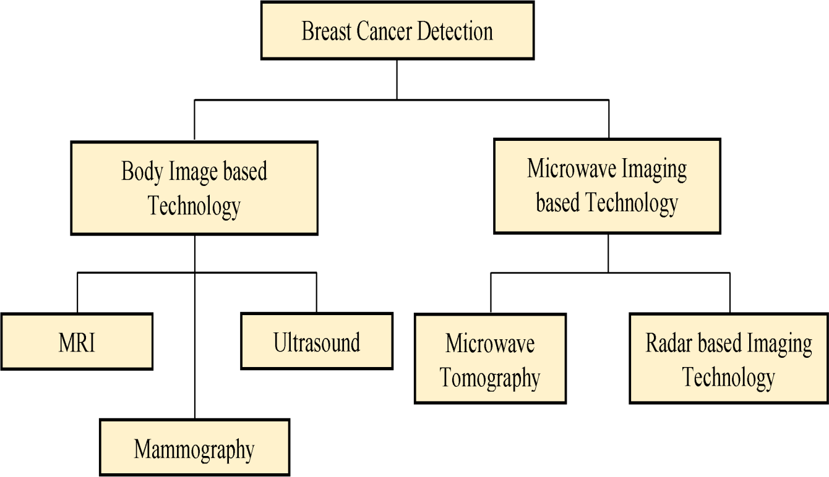
Fig:2.1 Block diagram of different modalities in breast cancer detection.

Slide 7
Problem Identification
The main goal of this project is to train an algorithm capable of classifying and detecting whether the patient is having malignant or benign cancer based on different given features such as clump thickness, uniform cell size, uniform cell shape, marginal adhesion, bare nuclei, mitoses, etc.
Machine Learning Algorithms
Breast Cancer Biopsy Data
Diagnosis
Fig:2.2 Diagnosis of breast cancer using ml

Slide 8
Schematic Layout OR Model Diagram
Dividing Dataset
Cancer Detection Data
Processing Data
into train and
test dataset
Performance Evaluation
Predict Result on Test Dataset
Train the Model
Results
Fig: 3.1
9

Slide 9
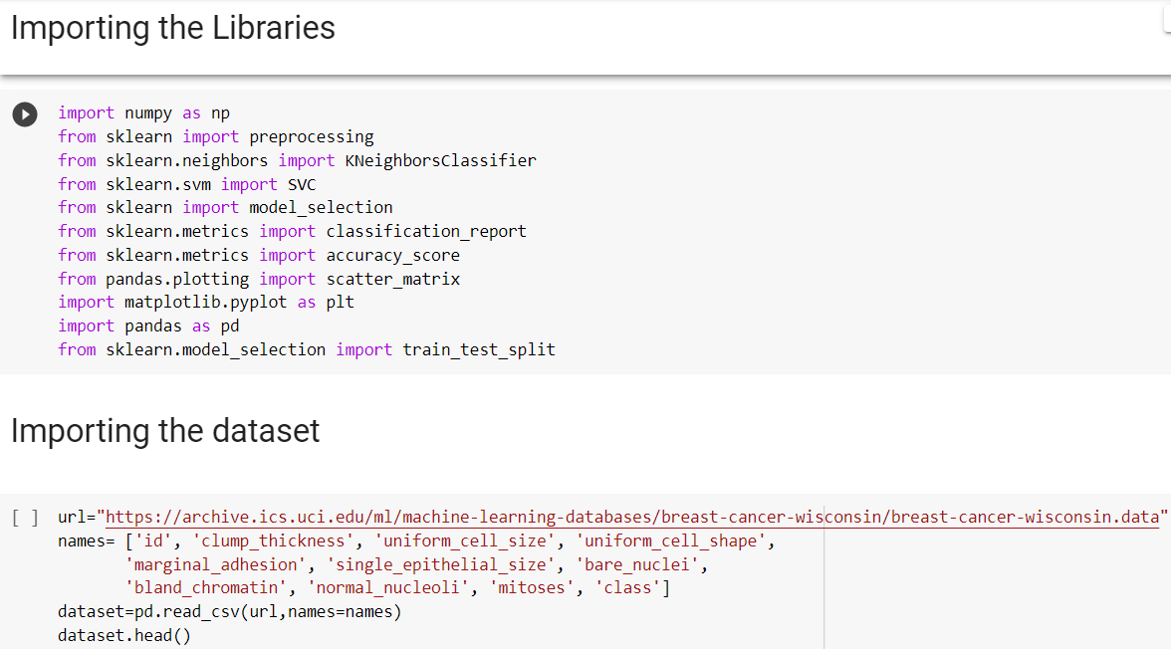
Methods OR Tools OR Algorithms used
Imported related libraries such as numpy, sklearn, pandas, matplotlib, etc.
Imported the dataset and stored it in the dataframe.
Fig.4.1 Importing libraries and dataset
10

Slide 10
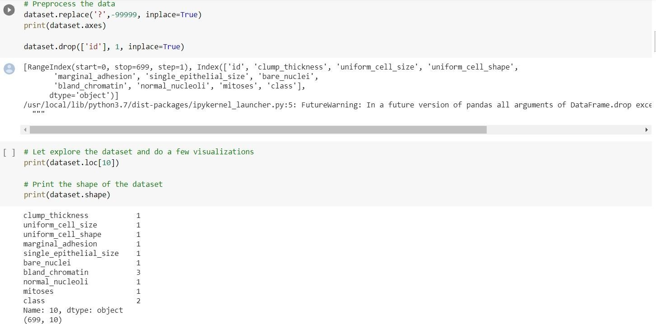
Removed the irrelevant columns.
Removed the duplicate rows.
Fig.4.2 Datacleaning

Slide 11
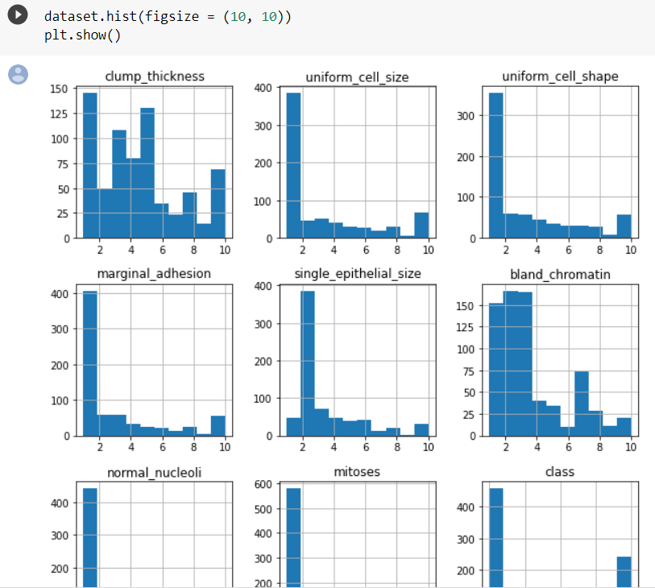
Fig. 4.3 Exploratory data analysis

Slide 12
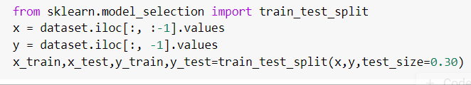
Split the dataset into two parts.
The first dataset only contains rows with no null data in that column. This dataset
is called t h e train dataset.
Second dataset only contains the rows that have null data in that column. This dataset is called the test dataset.
Fig 4.4
Splitting dataset

Slide 13
Algorithms
k-Nearest Neighbor algorithm(KNN)
Support Vector Machine(SVM)
Naive Bayes Algorithm
Decision Tree
Random Forest
Logistic Regression

Slide 14
k-Nearest Neighbor Algorithm(KNN)
Support Vector Machine(SVM)
It is a supervised learning algorithm.
The basic idea behind the classification using the k-nearest neighbor algorithm is that we plot all train data in the graph and when we have to test an output we have to count the outcomes of k nearest neighbor and the majority of the value is assigned to the test case as the outcome.
Support Vector Machine or SVM is one of the most popular Supervised Learning algorithms, which is used for Classification as well as Regression problems.
The goal of the SVM algorithm is to create the best line or decision boundary that can segregate n-dimensional space into classes so that we can easily put the new data point in the correct category in the future. This best decision boundary is called a hyperplane.

Slide 15
Naive Bayes Algorithm
Decision Tree
Decision Tree is a supervised learning algorithm. It’s a tree-like structure where branching represents a condition that is used to classify, that is each internal note denotes a test on a feature and each leaf note represents a class label.
A lot of computation is required to train and construct a decision tree. At each node, the list should be sorted in order to find the best split.
The source is divided into a subset which in turn is further divided which is done using recursion and the process is repeated based on another attribute.
Naive Bayes is a classification technique that is an extension of the Bayes theorem of probability.
It assumes that each feature contributes equally and is unique so this can be used in order to predict the outcome of certain events if we have enough prior data to calculate the probability of outcomes based on certain events that are given as input.
This is a powerful algorithm that works very well if a large dataset is provided.

Slide 16
Random Forest
Logistic Regression
Random Forest is a classifier that contains a number of decision trees on various subsets of the given dataset and takes the average to improve the predictive accuracy of that dataset." Instead of relying on one decision .
Random Forest is a popular machine learning algorithm that belongs to the supervised learning technique. It can be used for both Classification and Regression problems in ML.
Logistic regression is one more supervised learning algorithm used for classification in Machine learning.
Some can say that linear regression can also be used to solve this problem but linear progression can not be used as the linear regression equation doesn’t have a boundary it tends to reach infinity for larger values.
This is where logistic regression comes into play in order to keep the value of output or outcome within boundary.

Slide 17


Experimentation and Results
System Specification
Fig:5.1
Fig:5.2

Slide 18

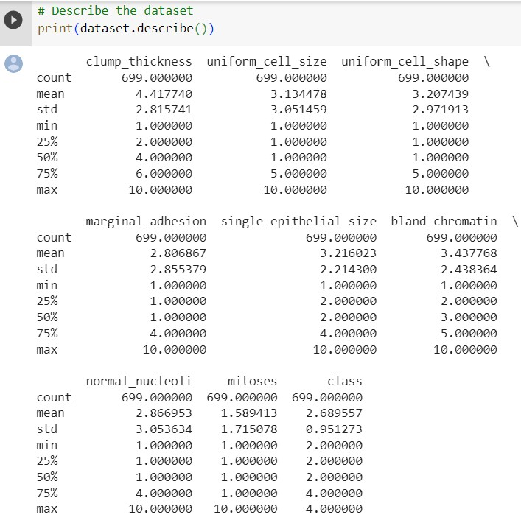
Dataset Description
Dataset URL:
https://archive.ics.uci.ed u/ml/machine-
learning-databases/breast-
cancer-wisconsin/breast-
cancer- wisconsin.data
Fig.5.3 Dara set of the breast cancer patient

Slide 19
Parameters used
Real-valued parameters:
Clump thickness
Uniform cell size
Uniform cell shape
Marginal adhesion
Single epithelial size
Bare nuclei
Bland chromatin
Normal nucleoli
Mitoses

Slide 20
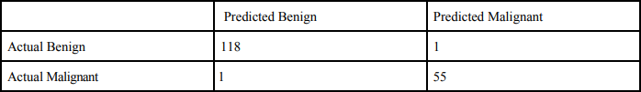
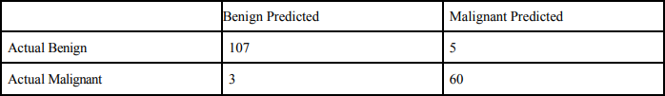
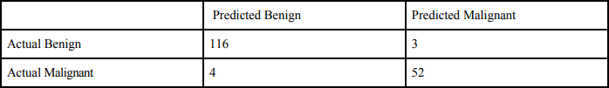
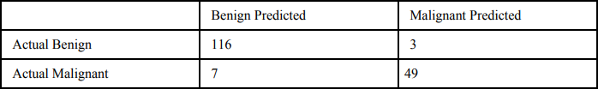
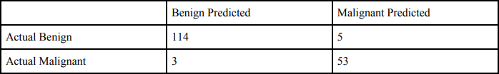
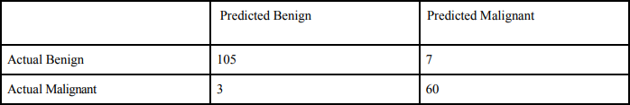
Experimental outcomes
Confusion Matrix
The confusion matrix is a matrix used to determine the performance of the classification models for a given set of test data. The matrix is divided into two dimensions, which are predicted values and actual values along with the total number of predictions.
Fig 5.4: Confusion Matrix for KNN Algorithm
Fig 5.6: Confusion Matrix for Decision Tree
Fig 5.5: Confusion Matrix for SVM
Fig 5.7: Confusion Matrix for Random Forest
Fig 5.5: Confusion Matrix for Naïve Bayes
Fig 5.8 Confusion Matrix for Logistic Regression

Slide 21
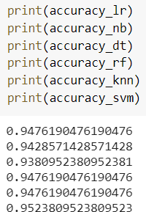
Result Analysis and Validation
We compared All classification techniques for the purpose of Breast cancer Detection and then found the best-predicted model.
After applying the different classification models, we have got accuracies with different models.
Fig:6.1 Compersion between algorithms based on accuracy
22

Slide 22
Conclusion and Future Scope (Key Findings)
According to their results, SVM can be considered an appropriate method
for Breast Cancer Prediction.
Further research in this field should be carried out for the better performance of the classification techniques so that it can predict more variables.
We are intending how to parametrize our classification techniques hence to
achieve high accuracy.
We are looking into many datasets and how further Machine Learning algorithms can be used to characterize Breast Cancer. We want to reduce the error rates with maximum accuracy.

Slide 23
Bibliography
1. UK Statistics Authority. Cancer statistics registrations: registrations of cancer diagnosed in 2004, England. London: UK Statistics Authority; 2007.
2. Department of Health. The national cancer registration system, 2008.
3. Breast Cancer Clinical Outcome Measures Project. BCCOM: Analysis of the management of symptomatic breast cancers diagnosed in 2004, 3rd-year report. 2007
4. https://www.mdpi.com/applsci/applsci-11-10753/article_deploy/html/images/applsci-11- 10753-g013-550.jpg.
5. https://www.mdpi.com/applsci/applsci-11-10753/article_deploy/html/images/applsci-11-
10753-g014-550.jpg
6. https://www.mdpi.com/applsci/applsci-11-10753/article_deploy/html/images/applsci-11- 10753-g015-550.jpg
7. https://www.mdpi.com/applsci/applsci-11-10753/article_deploy/html/images/applsci-11-
10753-g016-550.jpg

Slide 24

24

